Slide 1
IS AUDITS
IT audits: provide audit services where processes or data, or both, are embedded in technologies.
Subject to ethics, guidelines, and standards of the profession (if certified)
CISA
Most closely associated with ISACA
Joint with internal, external, and fraud audits
Scope of IT audit coverage is increasing
Characterized by CAATTs
IT governance as part of corporate governance

Slide 2
FRAUD AUDITS
Fraud audits: provide investigation services where anomalies are suspected, to develop evidence to support or deny fraudulent activities.
Auditor is more like a detective
No materiality
Goal is conviction, if sufficient evidence of fraud exists
CFE
ACFE

Slide 3
EXTERNAL AUDITS
External auditing: Objective is that in all material respects, financial statements are a fair representation of organization’s transactions and account balances.
SEC’s role
Sarbanes-Oxley Act
FASB - PCAOB
CPA
AICPA

Slide 4
EXPOSURES AND RISK
Exposure (definition)
Risks (definition)
Types of risk
Destruction of assets
Theft of assets
Corruption of information or the I.S.
Disruption of the I.S.
Notes:
EXPOSURE: Absence or weakness of a control
RISK: Potential threat to compromise use or value of organizational assets

Slide 5
THE P-D-C MODEL
Preventive controls
Detective controls
Corrective controls
Which is most cost effective?
Which one tends to be proactive measures?
Can you give an example of each?
Predictive controls

Slide 6
The five components of internal control are:
The control environment
Risk assessment
Information & communication
Monitoring
Control activities
Notes:
Control Environment. According to the COSO Report, the control environment “sets the tone of an organization and influences the control consciousness of its people.” It provides structure and discipline, and forms the foundation for all other components of internal control.
Risk Assessment. Risk assessment refers to the “identification, analysis, and management of risks relevant to the preparation of financial statements that are fairly presented in conformity with generally accepted accounting principles [GAAP] (or another comprehensive basis of accounting).”
Control Activities. Control activities are the policies and procedures that help ensure that management’s directives are carried out.
Information and Communication. The identification, capture and exchange of information in a form and timeframe that enables people to carry out their responsibilities.
Monitoring. In relation to the COSO report and SAS 78, monitoring refers to the process used to assess the quality of internal control performance over time.
Adequate internal control is a key defense (but no guarantee) against fraud, errors and program abuse.

Slide 7
SAS 78
The Auditing Standards Board of the American Institute of Certified Public Accountants (AICPA) incorporated the components of internal control presented in the COSO Report in its Statement on Auditing Standards No. 78 (SAS 78), entitled “Consideration of Internal Control in a Financial Statement Audit.”

Slide 8
SAS 78 (#1:Control Environment -- elements)
Describe how each one could adversely affect internal control.
The integrity and ethical values
Structure of the organization
Participation of audit committee
Management’s philosophy and style
Procedures for delegating
Notes:
Page 13

Slide 9
SAS 78 (#1:Control Environment -- elements)
Management’s methods of assessing performance
External influences
Organization’s policies and practices for managing human resources

Slide 10
SAS 78 (#1:Control Environment -- techniques)
Describe possible activity or tool for each.
Assess the integrity of organization’s management
Conditions conducive to management fraud
Understand client’s business and industry
Determine if board and audit committee are actively involved
Study organization structure

Slide 11
SAS 78 (#2:Risk Assessment)
Changes in environment
Changes in personnel
Changes in I.S.
New IT’s
Significant or rapid growth
New products or services (experience)
Organizational restructuring
Foreign markets
New accounting principles

Slide 12
SAS 78 (#3:Information & Communication-elements)
Initiate, identify, analyze, classify and record economic transactions and events.
Identify and record all valid economic transactions
Provide timely, detailed information
Accurately measure financial values
Accurately record transactions

Slide 13
SAS 78 (#3:Information & Communication-techniques)
Auditors obtain sufficient knowledge of I.S.’s to understand:
Classes of transactions that are material
Accounting records and accounts used
Processing steps:initiation to inclusion in financial statements (illustrate)
Financial reporting process (including disclosures)

Slide 14
SAS 78 (#4: Monitoring)
By separate procedures (e.g., tests of controls)
By ongoing activities (Embedded Audit Modules – EAMs and Continuous Online Auditing - COA)

Slide 15
SAS 94 The Effect of Information Technology on the Auditor’s Consideration of Internal Control in a Financial Statement Audit
Provides auditors with guidance on IT’s effect on internal control and on the auditor’s understanding of internal control and the assessment of control risk.
Requires the auditor to consider how an organization’s IT use affects his or her audit strategy.
Where a significant amount of information is electronic, the auditor may decide it is not practical or possible to limit detection risk to an acceptable level by performing only substantive tests for one or more financial statement assertions. In such cases, the auditor should gather evidence about the effectiveness of both the design and operation of controls intended to reduce the assessed level of control risk.
Notes:
SAS No. 94 and Tests of Controls
Under the auditing standards (SAS Nos. 48, 55 and 78) relevant to computer-based systems issued prior to SAS No. 94, a large percentage of auditors assessed control risk at the maximum and performed only substantive tests of account balances and classes of transactions to gather evidence about financial statement assertions. SAS No. 94 recognizes that this approach may not be viable in complex IT environments. When evidence of a firm's initiation, recording and processing of transactions exists only in electronic form, the auditor's ability to obtain the desired assurance only from substantive tests is significantly diminished. SAS No. 94 does not change the requirement to perform substantive tests on significant amounts, but states that "it is not practical or possible to restrict detection risk to an acceptable level by performing only substantive tests."3 When assessing the effectiveness of the design and operation of controls in complex IT environments, it is necessary for the auditor to test these controls. The decision to test controls is not related to the size of the firm but to the complexity of the IT environment.

Slide 16
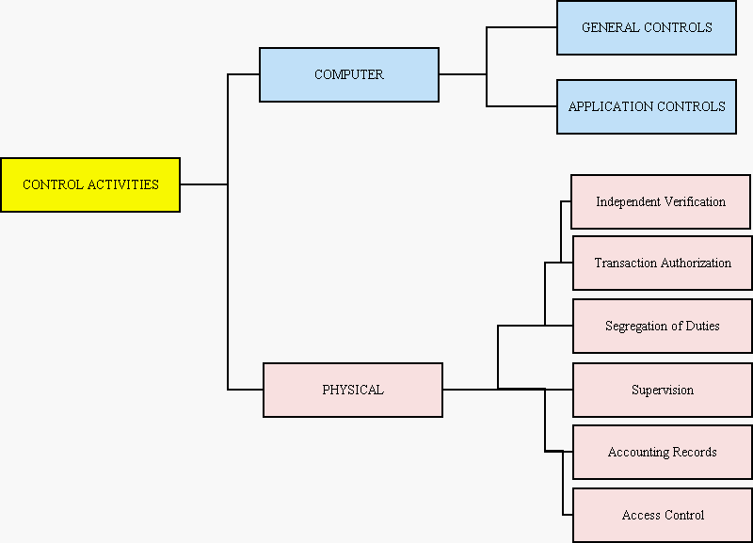
SAS 78 (#5: Control Activities)

Slide 17
Physical Controls (1-3)
Transaction authorization
Example:
Sales only to authorized customer
Sales only if available credit limit
Segregation of duties
Examples of incompatible duties:
Authorization vs. processing [e.g., Sales vs. Auth. Cust.]
Custody vs. recordkeeping [e.g., custody of inventory vs. DP of inventory]
Fraud requires collusion [e.g., separate various steps in process]
Supervision
Serves as compensating control when lack of segregation of duties exists by necessity

Slide 18
Physical Controls (4-6)
Accounting records (audit trails; examples)
Access controls
Direct (the assets)
Indirect (documents that control the assets)
Fraud
Disaster Recovery
Independent verification
Management can assess:
The performance of individuals
The integrity of the AIS
The integrity of the data in the records
Examples

